Slide 1
Manx Research Presentation
Misha Auchynnikau & Phoebe Austin

Slide 2
Background of
the Manx Language - 1
Manx (also known as Gaelg) is a Goidelic Language likely derived from Primitive Irish, being related to Irish and Scots Gaelic.
Believed to have originated around the 13th century AD, with first recorded usage in 1615.
Proto-Indo European
d
Proto-Celtic
d
Primitive Irish
d
Manx
Basic Language Evolution from PIE to Manx

Slide 3
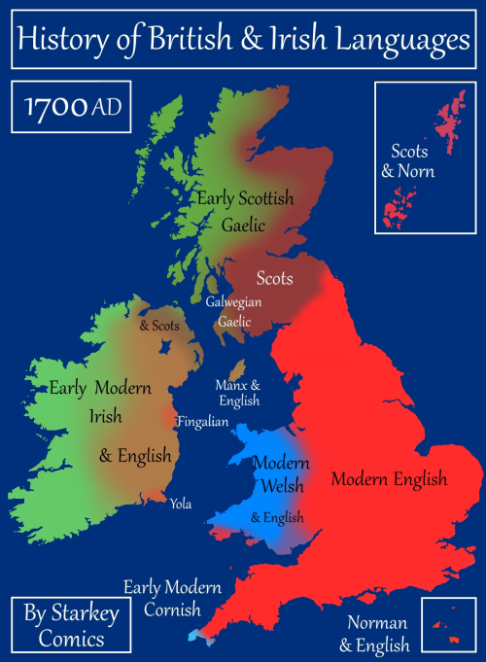
Background of
the Manx Language - 2
From the 15th to the 20th centuries, Manx diverged linguistically from Irish and Scots Gaelic considerably.
During the 18th century, England suppressed the Manx language on the island, pushing for only English within schools & churches on the island.
Decline started as the language garnered a low “linguistic prestige”.

Slide 4
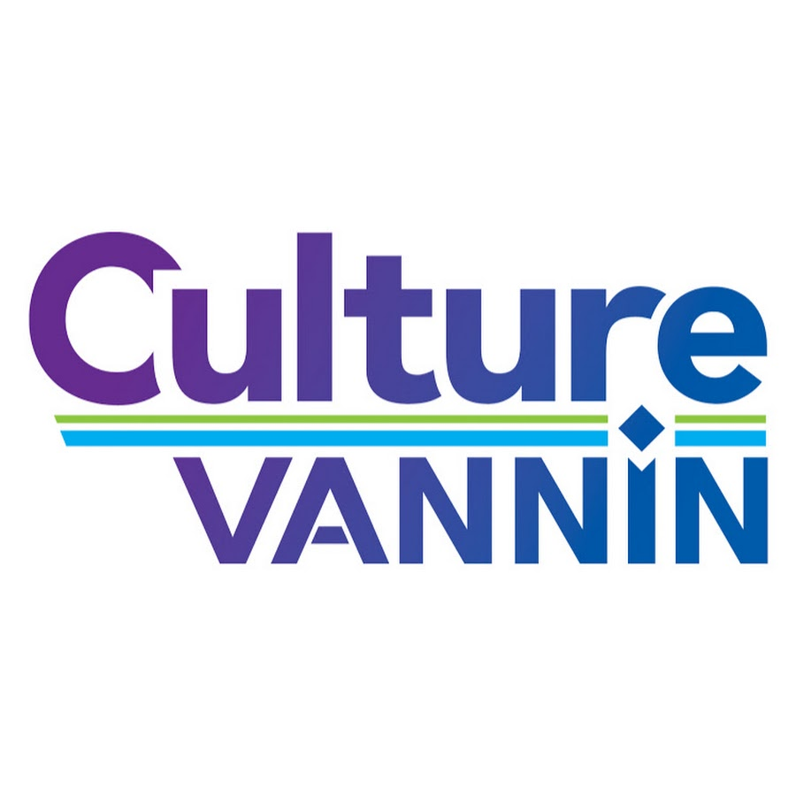
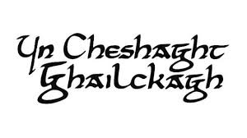

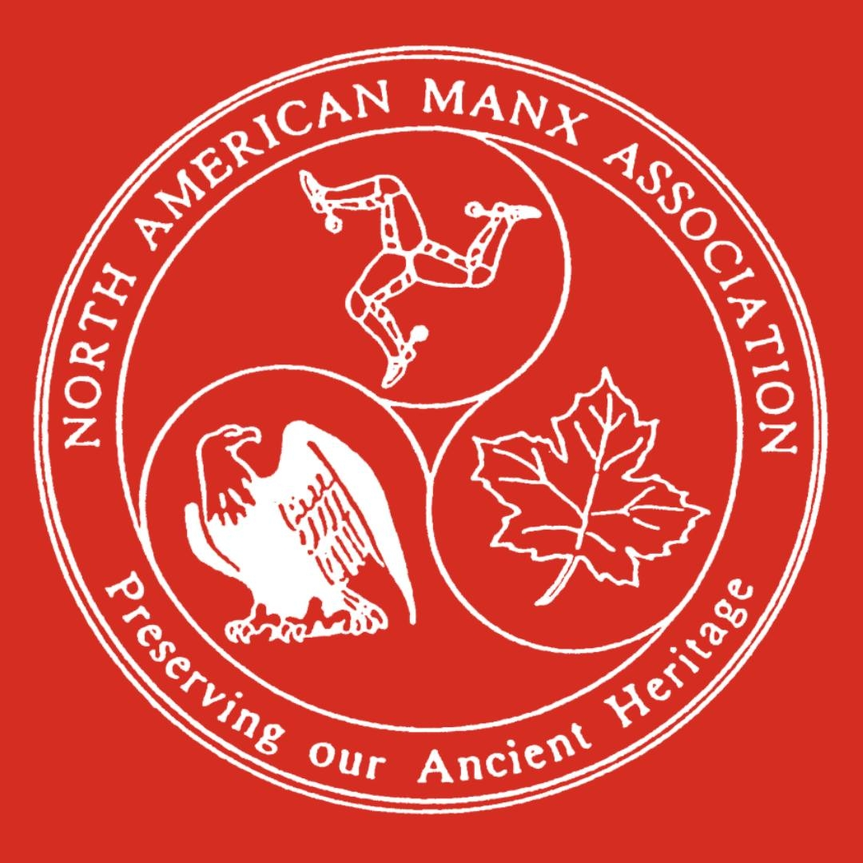

Background of
the Manx Language - 3
Throughout the 20th century, small efforts from linguists began to research and document the language.
In 2009, UNESCO incorrectly declared Manx an extinct language, sparking outrage.
The 21st century has seen increased revitalization activity for Manx by many groups (including Lost Worlds Institute).

Slide 5
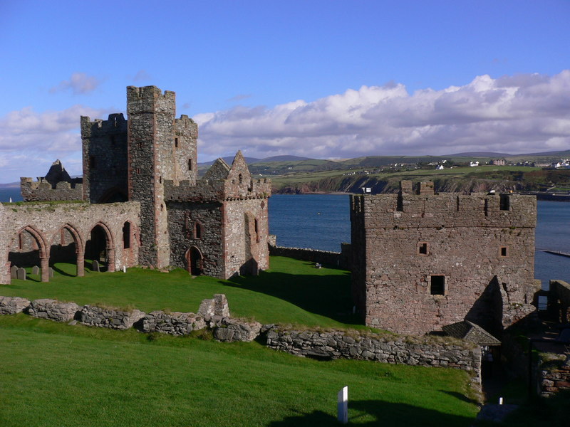
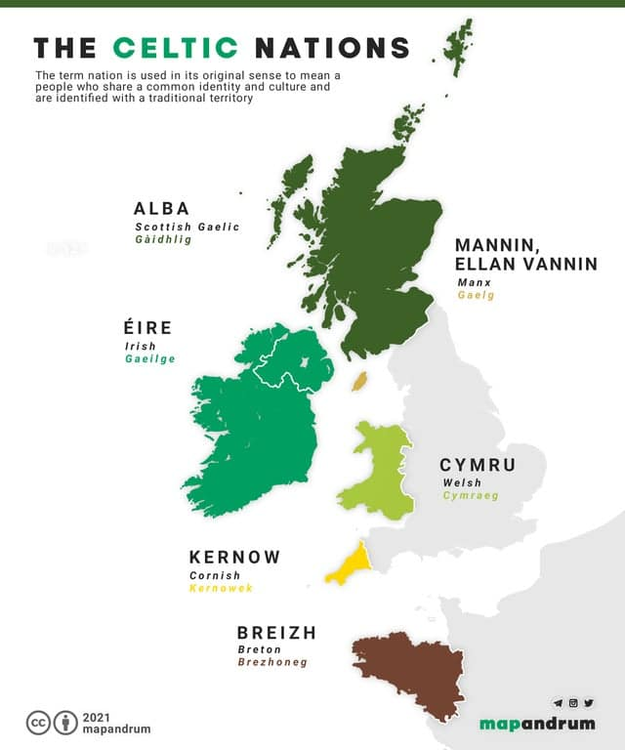
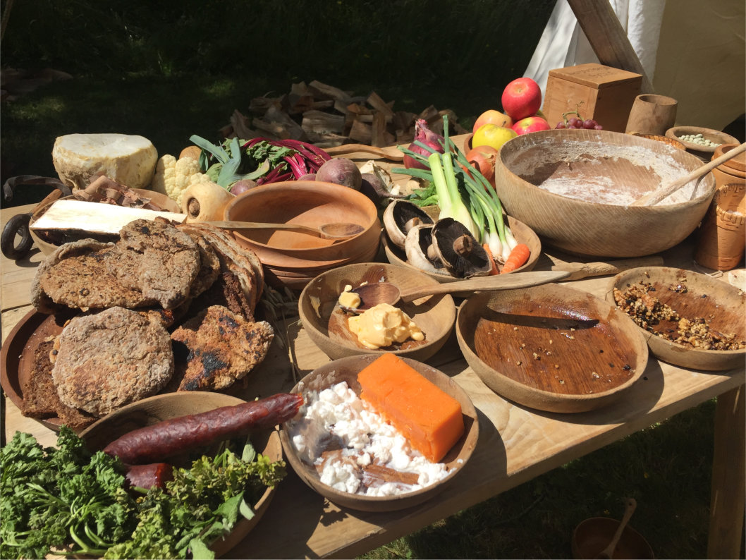
Overview of Manx Culture - 1
Many aspects of Manx culture are derived from its Gaelic (and Celtic) roots, as well as its proximity to the United Kingdom.
Cuisine includes lots of seafood, and commercially farmed poultry and cattle. Traditional foods include staples like, smoked fish, scallops (Manx Queenies), and Bonnag, a traditional bread.
Most surviving literature has a religious, primary consisting of Anglican Christianity, followed by non-religious contexts.

Slide 6
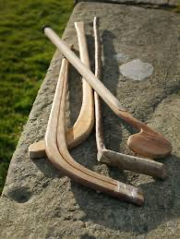
Overview of Manx Culture - 2
The Isle of Man also has prevalent folklore and storytelling traditions, often including mythical creatures, examples include:
Moddey Dhoo, a ghost-like black dog that wandered Peel Castle, rumoured to be scaring guards
Glashtyn, a shapeshifter, or hairy goblin in some tellings that resides in water
The music of the area in the 19th century was heavily Christian worship music, before the 15th century, many musical traditions had scandinavian roots and some similarities to Irish songs.
Sport on the island included Cammag, a sport similar to Irish hurling, by participation died out but the start of the 20th century. The Isle hosts an international motorcycle race, starting in 1907, which was formerly part of the world championship. This event contributes to the Isles sense of community and economy.
An example of a traditional Cammag stick

Slide 7
Research & Documentation Process
1. Parsing Online Sources
Student Researches look parse through various credible linguistic papers found online.
2. Compiling Shared Findings
Student Researchers compile findings into shared documents and is mutually reviewed & edited.
3. Formatting with Experts
The Research Paper is then typed and formatted with the help of Linguistics PhD Mentors.

Slide 8
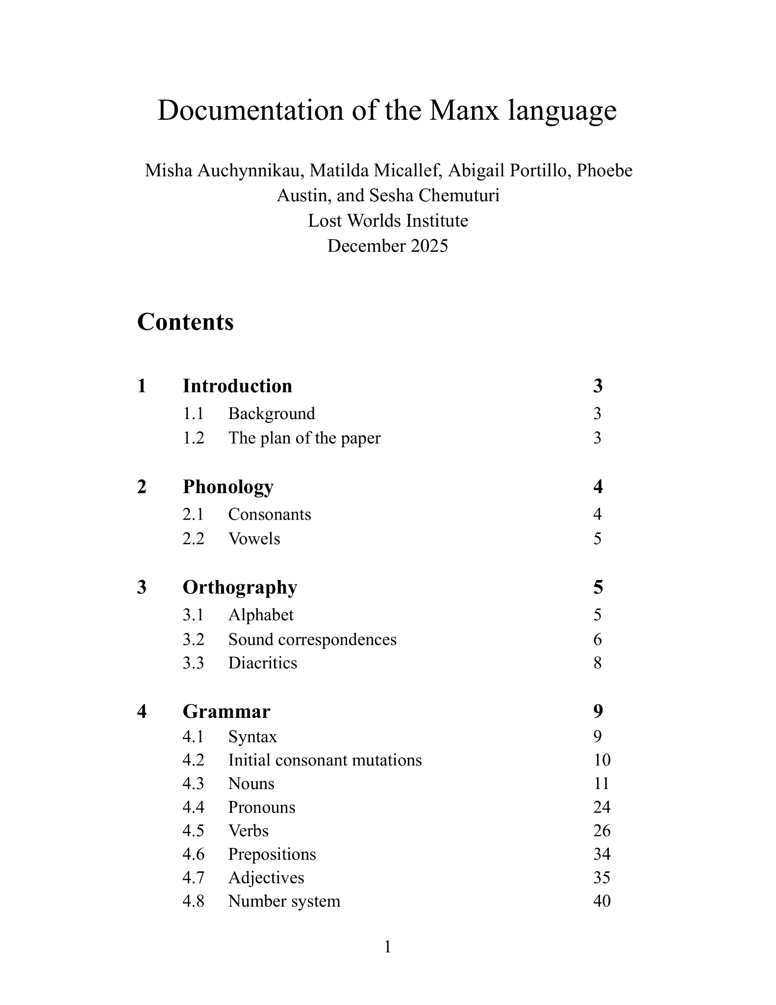
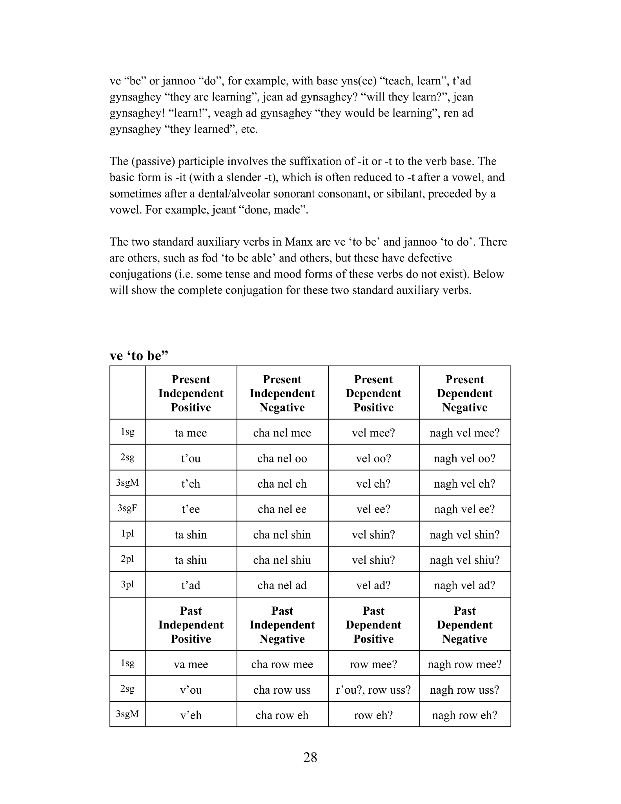
Examples of Our Research

Slide 9
Details of the Research Paper
1.
2.
3.
4.
Phonology
Orthography
Phonemic Inventory & “Slender” vs “Broad” distinction.
Unstandardized spelling convention & sound correspondences.
Morphology
Syntax
Noun Classes, Conjugation, Declension, & Tense-Aspect-Mood.
VSO sentence order, Modal/Auxiliary Verbs, & Semantics.

Slide 10
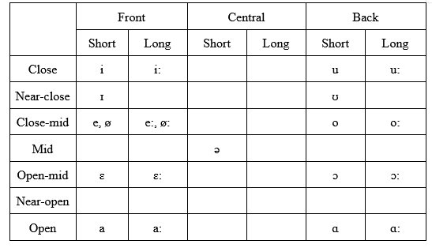
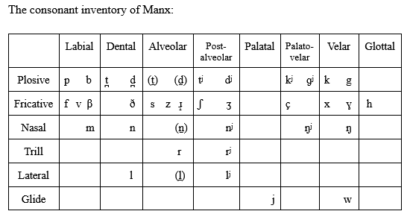
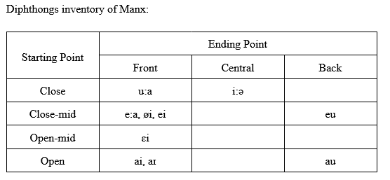
Phonology

Slide 11
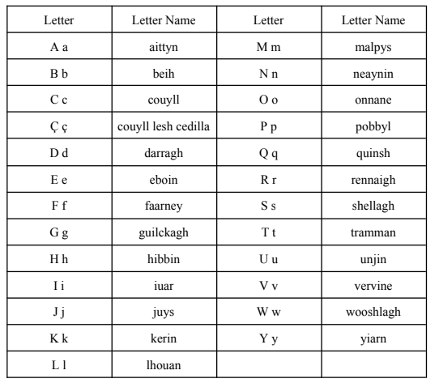
Orthography
Ç ç (couyll lesh cedilla), used to denote the /tʃ/ sound in the digraph [çh].
The diaeresis [◌̈] is used to separate vowel sounds and is used in irregular plural formations.

Slide 12
Morphology - Noun & Their Classes
Classes make no distinction
between masculine and feminine nouns.
Class 1
Subclass 1a
Subclasses 1a1, 1a2
Class 2
Subclass 1b
Subclass 1b
Subclass 1c
Subclasses 1c1, 1c2, 1c3
Class 3
Subclass 1d
Subclasses 1d1, 1d2, 1d3
Class 4
Subclass 1e
Subclass 1e1, 1e2
Class 5
Subclass 1f
Subclass 1f

Slide 13
Morphology - Verbs & Conjugations
Tenses
Aspects
Moods
Simple (Neutral)
Indicative
Present
Progressive
Imperative
Past
Perfect
Conditional
Future
Perfect Progressive
Interrogative*

Slide 14
Morphology - Verbs & Conjugations
Non-Finite Forms
Voices
Finite Forms
Verbal Nouns
Active
Independent
Gerunds
Passive
Dependent
Passive Participles

Slide 15
Verb Conjugation - 1
Verbal Noun + Inflected Auxiliary Verb (Periphrasis)
ymmyrkey + ta shin = ta shin gymmyrkey
“bearing” + “to be” (1pl) = “we are bearing”
Inflected Verb in Future, Pertirite, or Imperative Tense (Synthesis)
brishey ⇾ brishys
“breaking” ⇾ “It will break” (3sgM)

Slide 16
Verb Conjugation - 2
Verb Form
Translation
ynsee
to learn
t’ad gynshagey
they are learning
jean ad gynshagey?
will they learn?
jean gynshagey!
learn!
veagh ad gynshagey
they would be learning
ren ad gynshagey
they learned

Slide 17
Syntax
Hug yn saggyrt e laue urree.
put-PRET the priest his hand on her.
‘The priest put his hand on her.’
Cha jarg shiu fakin red erbee.
not can you-PL see-V.N. anything.
‘You all can’t see anything.’

Slide 18
Can Manx be preserved in similar ways to other Gaelic Languages?

Slide 19
Preservation Tactics of the Irish Language
1. Gaelscoilenna
Large numbers of both State-sponsored and private schools teach Irish-based curricula.
2. Modern Cultural Adaption
More Irish bands and artists make songs in Irish, as well as fashion brands and movies centered on Irish heritage.
3. Regional State Agencies
Government gives financial and educational support to regions where Irish is the predominant language.

Slide 20
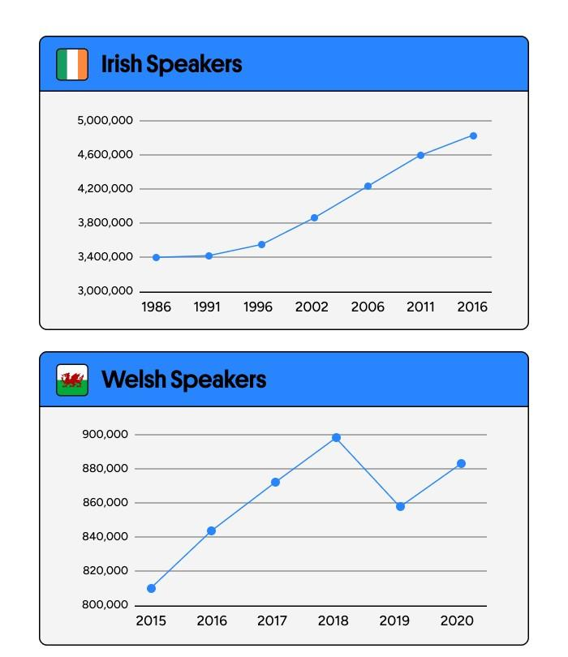
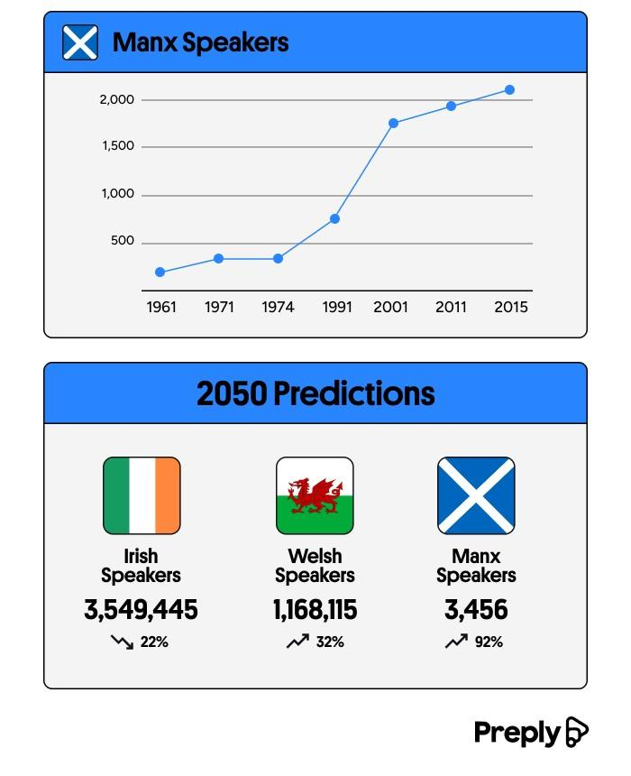
Potential Hope for Gaelic Languages?

Slide 21
Questions & Answers

